Slide 1



Intelligent Classic Snake
Python GAME
IT345 Software Group Project-II
Prepared By :-
16IT024
Umang Gohel

Slide 2
Contents
Overview
Problem & Solution
Tools & Technologies
Scope
Technology Used
Future Goal

Slide 3
Introduction
It is a small game for the purpose of enjoyment. Basically it’s an old mobile game which is in old Nokia phones.
It will include computer controlled intelligent opponents whose aim will be to challenge the human players. It will also have the multiplayer feature.

Slide 4
Problem & solution
Multiplayer option in this game still I didn’t see so, I will try to make a play such kind of game in multiplayer.
This project explores a new dimension in the traditional snake game to make it more interesting and challenging.

Slide 5
Tools & Technologies
Programming language : Python
IDE : Anaconda
Spyder, Jupyter.

Slide 6
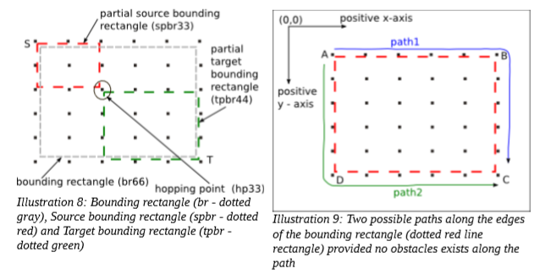
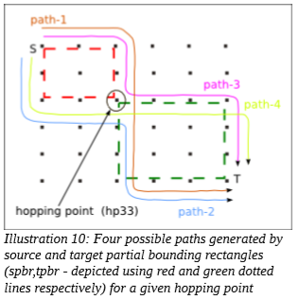
Path finding algorithm

Slide 7
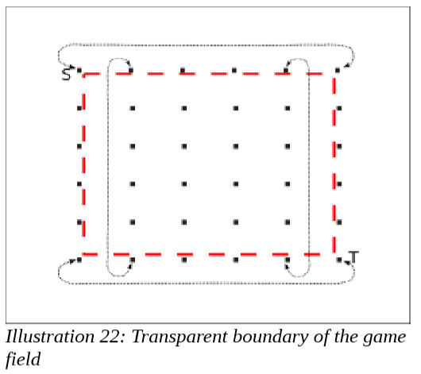
continue
Limitations

Slide 8
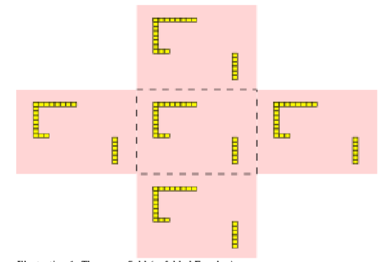
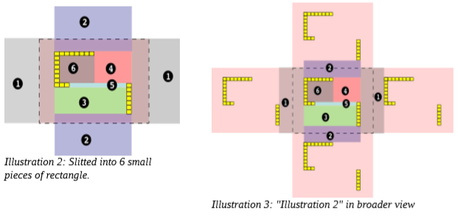
continue

Slide 9
scope
Introduce computer controlled intelligent opponent
The movement and action of these intelligent opponents will be controlled by computer
The simplicity of this game makes it an ideal candidate for a minor project as we can focus on advanced topics like multiplayer functionality and implementation of computer controlled intelligent opponents.

Slide 10
Learning tools
For achieving this objective I learn a new language Python.
Spyder and jupyter and some inbuilt library of python etc.
NPTEL and coursera for learning the python

Slide 11
Future goal
Make an attractive GUI game and also reliable to play a such kind of game.
Multi window and make a computer intelligent which play with the opponent
Increases the complexity of level

Slide 12
THANK YOU

